Slide 1
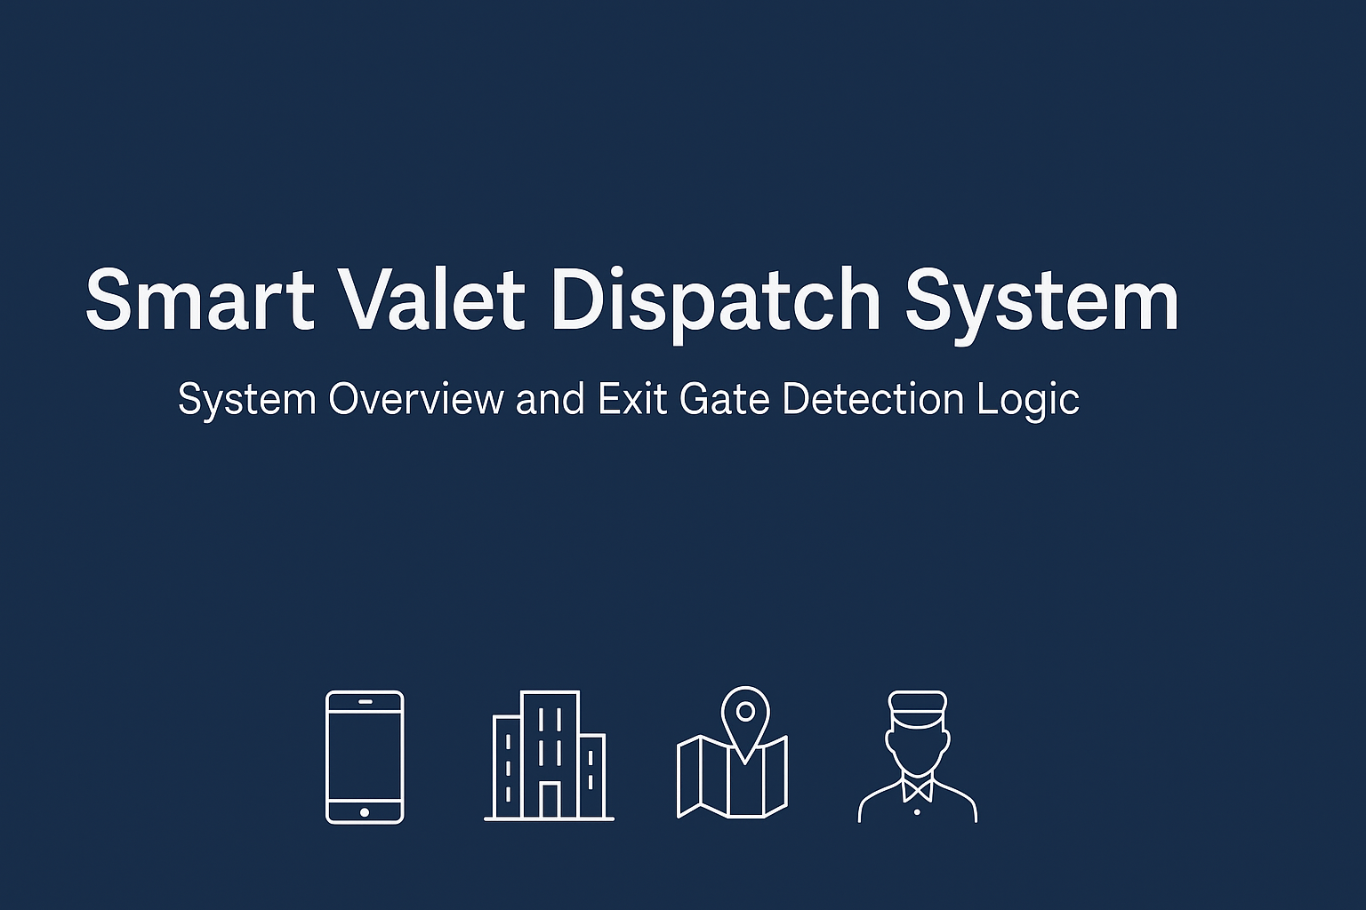
Smart Valet Dispatch System
System Overview and Exit Gate Detection Logic

Slide 2
System Overview
Our Smart Valet Dispatch System is designed to predict the exit gate a customer is approaching in a multi-gate mall scenario and dispatch their vehicle accordingly, without requiring manual input.
Key Components:
Customer Mobile App (Web/ App): Initiates car request, passively sends location data
Location Detection Layer: Uses GPS, Wi-Fi triangulation, Bluetooth beacons
Backend Intelligence Engine: Predicts most likely exit gate using real-time & historical data; triggers dispatch request
Valet Dashboard (Tablet/Terminal): Receives gate-specific dispatch alerts with car details
Beacon Sensors at Gates (Optional but recommended)For precise proximity tracking at exits

Slide 3
Exit Gate Detection Logic
Location Tracking :-
App passively tracks user location Uses GPS + Wi-Fi positioning + Bluetooth beacon signals
Determines approximate location (~10-20m)
Geofencing & Gate Proximity Zones :-
Each exit gate is surrounded by a soft geofence (e.g, 50 m radius)
When user enters geofence and moves toward a gate, increases confidence
Prediction Algorithm :-
Factors in
Current movement direction
Time to walk to each gate
Recent GPS/Bluetooth signals
Historical behaviour (if repeat user)
Congestion at gates (optional via admin)
Final Decision :-
When confidence > threshold (e.g., 75%, dispatch is sent to that gate's valet
If uncertainty remains, default to nearest gate

Slide 4
[User requests car]
↓
[App tracks movement]
↓
[Backend predicts gate]
↓
[Dispatch car to gate]
↓
[User exits → car waiting]

